Slide 1
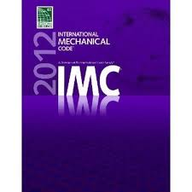
S&P USA & the 2012 International Residential and Mechanical Code for Ventilation

Slide 2
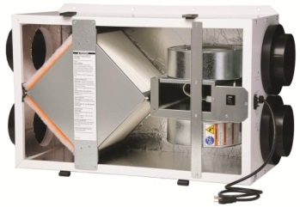
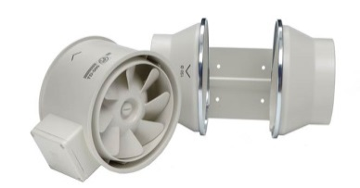
S&P and IRC/IMC 2012
Presentation Objectives
To understand sections of IRC concerning ventilation
To understand sections of IMC concerning ventilation
Identify S&P compliance options

Slide 3
Chapter 15: The code in regards to ventilation
Section 1

Slide 4
IRC 2012: Chapter 15
Sections Requiring Ventilation
Clothes Dryer Exhaust (M1502)
Range Hood Exhaust (M1503)
Mechanical Ventilation (M1507)
Whole-house Ventilation
Local Exhaust

Slide 5
Section M1502: Clothes Dryer Exhaust
The Code Specifies:
The dryer exhaust MUST terminate to the outside
The MAX. length of the [dryer] exhaust duct is 35’ from the connection to the outlet terminal
Problem Created by Code:
What if the dryer is NOT located close to the outlet terminal?
What if the duct is longer than 35’ so elbows are necessary creating complicated duct work? (ref. table 1502.4.4.1)
FACT: When ducting from a dryer to the outlet is long and/or complicated the dryer cannot overcome the static pressure thus reducing efficiency and causing increased or poor drying time.
S&P’s Solution:
A Clothes Dryer Booster Fan will help overcome the static pressure created from long and/or complicated duct runs.
Section 1502 M1502

Slide 6
S&P Solution for M1502
PV100X with Current Sensor
Centrifugal blade design capable of overcoming extreme resistance (high static pressure)
Class F insulation
“Fail-safe” activation method with Current Sensor
Fan only runs when device senses current
Section M1502 Clothes Dryer Exhaust

Slide 7
Section M1503: Range Hoods
The Code Specifies:
Makeup air is required when system is capable of exhausting 400+ CFM
Rate of makeup air must be (approx.) equal to the exhaust air
Why You Need S&P:
Simple...Makeup Air!
S&P’s Solutions:
GOOD: TD-MIXVENT (Mixed Flow Fan)
BEST: TD-SILENT (Mixed Flow Fan)
Section M1503 Range Hoods

Slide 8
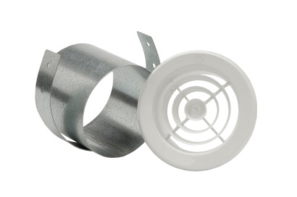
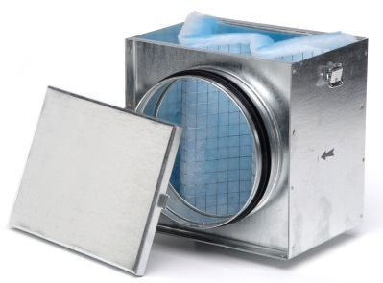
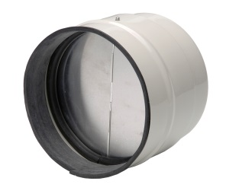
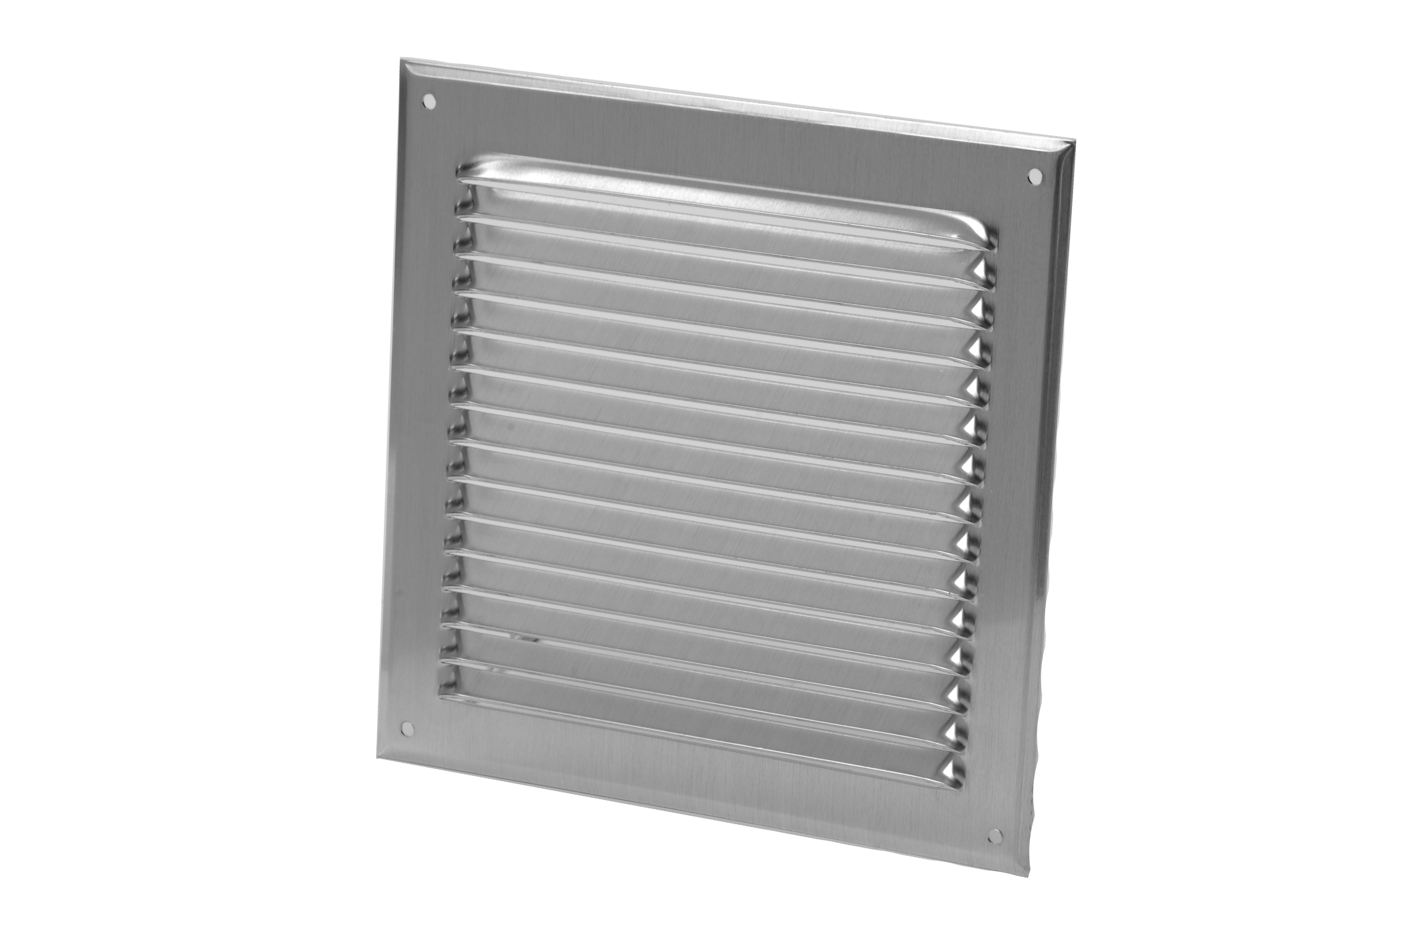
Good Solution for Makeup Air
TD MIXVENT: Mixed Flow Fan
TD-200 with filter box & backdraft damper
Meets the requirement
Prevents cold air from infiltrating
Filters the incoming air
Distributes air through a small round grille
Brings air in through an aluminum outdoor grille
The TD-200 operates at 2 sones! That’s just twice as loud as a refrigerator.
Section M1503 Range Hoods

Slide 9
Better Solution for Makeup Air
TD SILENT: Extremely Quiet Mixed Flow Fan
TD-200S w/filter box & backdraft damper
Meets the requirement
Prevents cold air from infiltrating
Filters the incoming air
Distributes air through a small round grille
Brings air in through an aluminum outdoor grille
The TD-200S Silent operates at .5 sones! That’s ½ as quiet as a refrigerator.
Section M1503 Range Hoods

Slide 10
Section M1507: Mechanical Ventilation
The Code Specifies:
Whole-house Ventilation AND Local Exhaust is required
Bathroom & toilet air must be exhausted directly to the outdoors and shall not be recirculated within residence
We will start with the Whole-house Ventilation Requirements
Whole-house Ventilation Requirements
One or more supply or exhaust fans, plus associated ducts and controls
Local exhaust or supply fans contribute to the whole-house ventilation requirement
System must have controls that enable manual override
Outdoor (makeup) air must be provided at a continuous rate (ref. Table 1507.3.3)
Exception: if you use controls that enable operation for at least 25% of each 4 hour segment you can operate intermittently
Section M1507 uses the ASHRAE 62.2 Standards
Section M1507 Mechanical Ventilation

Slide 11
Whole House Ventilation
Table 1507.3.3: The amount of whole house ventilation that is required to meet the standard.
DWELLING UNIT FLOOR AREA (square feet) | NUMBER OF BEDROOMS
 | 0-1 | 2 -3 | 4 -5 | 6-7 | > 7
 | Airflow in CFM
< 1,500 | 30 | 45 | 60 | 75 | 90
1,501-3,000 | 45 | 60 | 75 | 90 | 105
3,001-4,500 | 60 | 75 | 90 | 105 | 120
4,501-6,000 | 75 | 90 | 105 | 120 | 135
6,001-7,500 | 90 | 105 | 120 | 135 | 150
> 7,500 | 105 | 120 | 135 | 150 | 165
For SI: 1 square foot = 0.0929 m², 1 cubic foot per minute = 0.0004719 m³/s.
Section M1507 Mechanical Ventilation

Slide 12
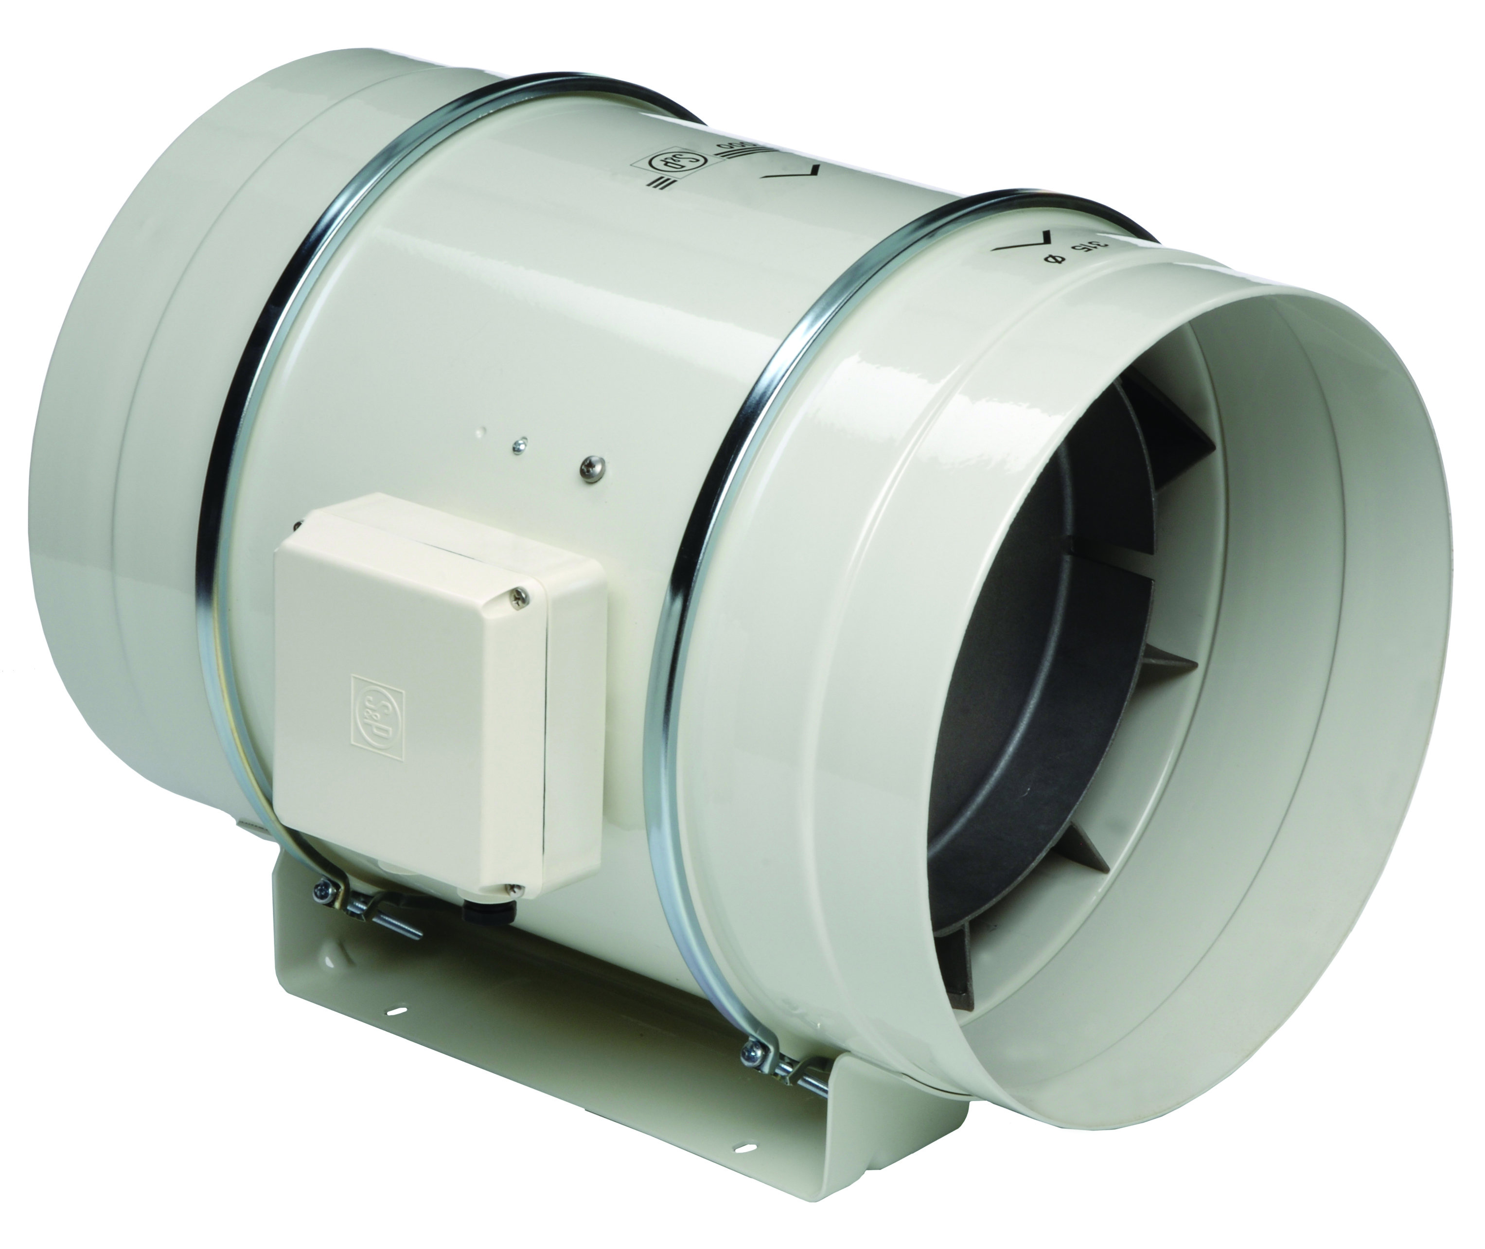
Good Solution: Whole House Ventilation
PC-Premium CHIOCE Fan (Exhaust)
TD-MIXVENT Fan (Supply)
The PC Fan will run continuously for exhaust
The TD will provide outdoor air continuously
A speed control should be used to set the TD to match the PC performance
You meet the code but don’t exceed it!
Section M1507 Mechanical Ventilation

Slide 13
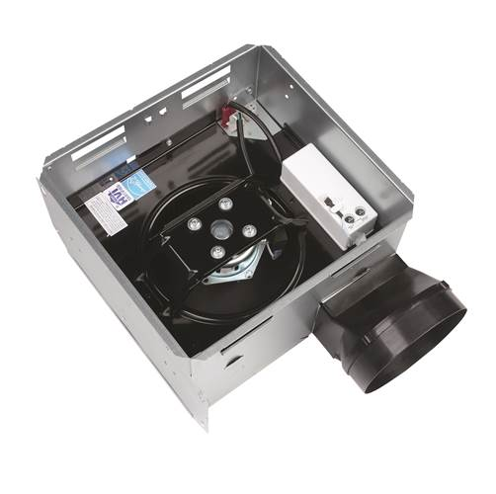
Exhaust Side of Good Solution
Install PC fan in hallway or other area away from the living space
Motors rated for 30,000 hours continuous on
The extremely low sound levels ensure the PC will not be intrusive
ENERGY STAR® qualification ensures the fan reduces energy consumption without sacrificing performance
PC Bonus Feature:
Simple Plug-&-Play Speed Control
PCSC option allows you to set the continuous speed requirement. No separate wall control needed!
Section M1507 Mechanical Ventilation

Slide 14
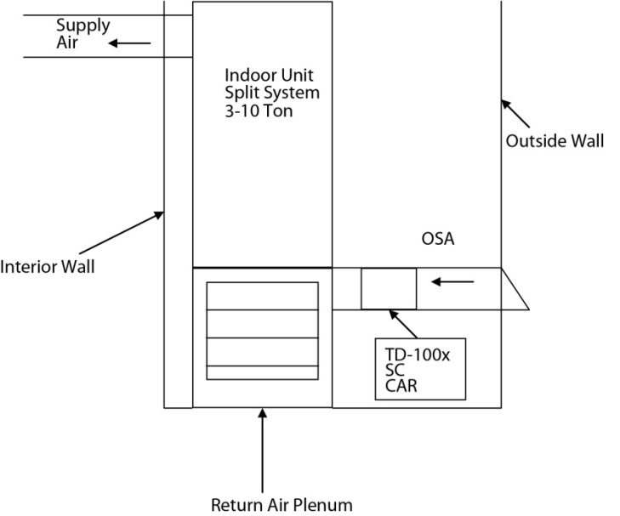
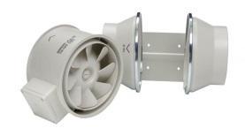
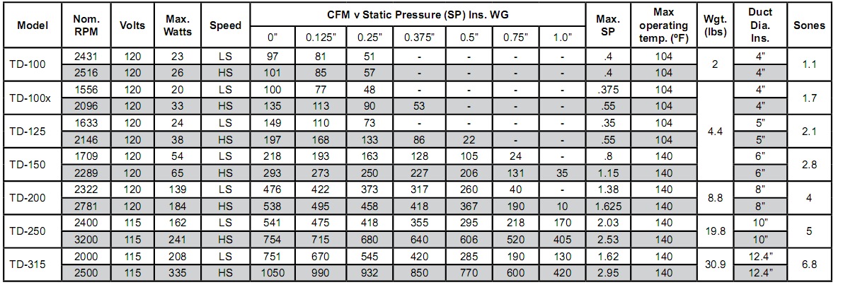
Supply Side of the Good Solution
Insert TD Fan into the outside air duct
Set the performance for the whole house requirement and the exhaust requirement totaling the makeup air
Section M1507 Mechanical Ventilation

Slide 15
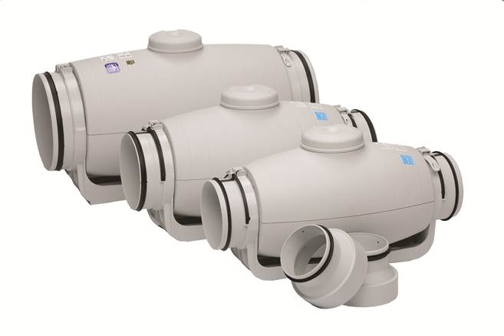
Better Solution for Whole House Ventilation
TD-SILENT: REQUIRES 2 FANS
Exhaust Fan set at the required airflow for installed in hallway
Supply Fan in the outside air duct set at the requirement for Kitchen Ventilation, Bathroom Ventilation, & Whole House ventilation.
Section M1507 Mechanical Ventilation

Slide 16
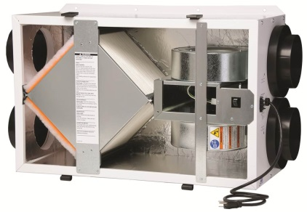
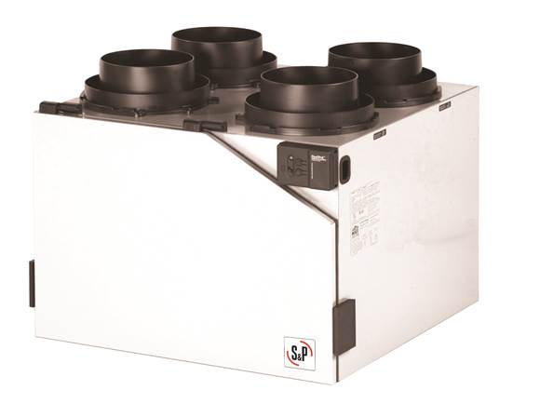
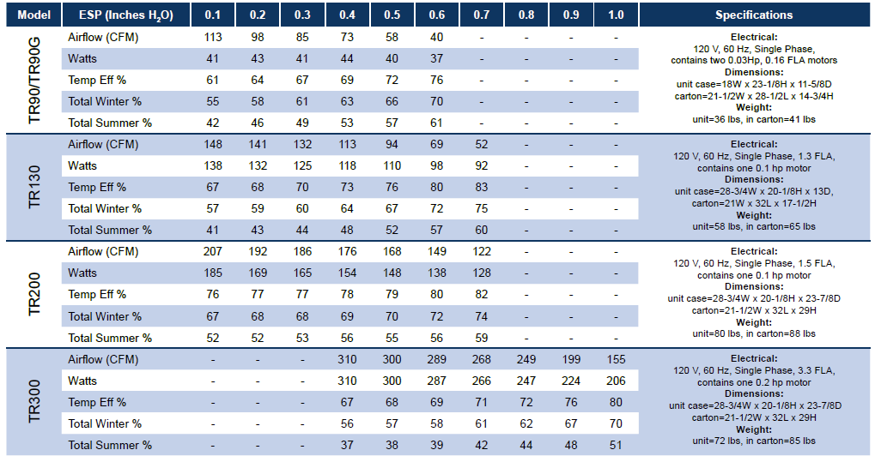
Best Solution for Whole House Ventilation
TR: Energy Recovery Ventilator OR
HR: Heat Recovery Ventilator
Use ERV or HRV to bring in the outside air AND exhaust the air to meet the requirement
With S&P TR or HR the exhaust and supply air do not mix in the core
No need to worry about bathroom air cross contamination so it meets the code (see following sides for airflow animation)
Section M1507 Mechanical Ventilation

Slide 17
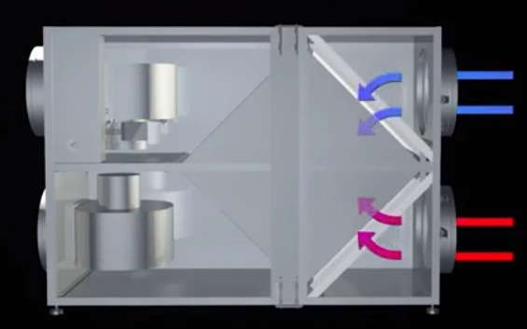

Slide 18
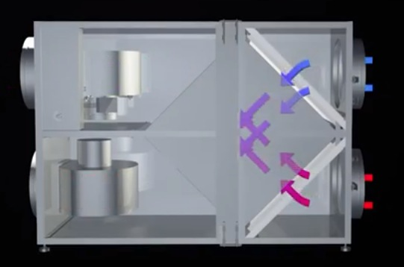

Slide 19
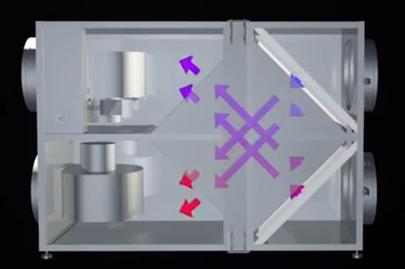

Slide 20
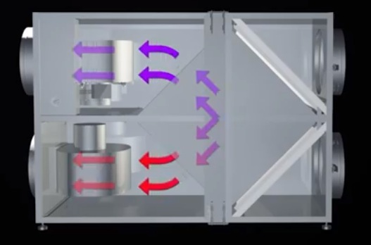
z

Slide 21
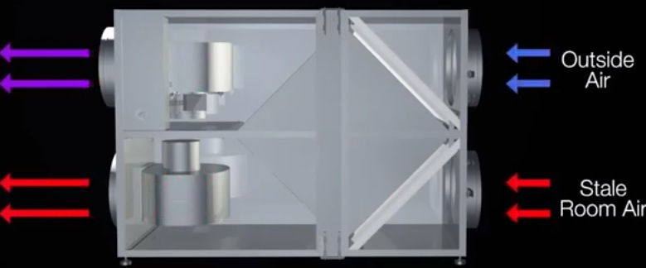

Slide 22
Section M1507: Mechanical Ventilation
Whole-house Ventilation Requirements EXCEPTION
Exception: The whole-house mechanical ventilation system is permitted to operate intermittently where the system has controls that enable operation for not less than 25-percent of each 4-hour segment and the ventilation rate prescribed in Table M1507.3.3(1) is multiplied by the factor determined in accordance with Table M1507.3.3(2).
Section M1507 Mechanical Ventilation

Slide 23
Section M1507: Mechanical Ventilation
EXCEPTION: Whole-house Ventilation Specifies:
Outdoor (makeup) air must be provided at a continuous rate (ref. Table 1507.3.3)
Exception: if you use controls that enable operation for at least 25% of each 4 hour segment you can operate intermittently.
Use Chart 1503.3.3 to determine intermittent factor (Whole House Required CFM x Factor = Intermittent CFM):
RUN-TIME PERCENTAGE IN EACH 4-HOUR SEGMENT | 25% | 33% | 50% | 66% | 75% | 100%
Factor | 4 | 3 | 2 | 1.5 | 1.3 | 1.0
Exception Example: 2000 sq. ft. Home with 2 Baths
Whole House Requirement = 60 CFM continuous
Exception: Use a timer to run fan 25% of the four hour period
The intermittent CFM requirement would be 240 CFM to operate at 25%
Section M1507 Mechanical Ventilation

Slide 24
Section M1507: Mechanical Ventilation
The Code Specifies:
Whole-house Ventilation AND Local Exhaust is required
Bathroom & toilet air must be exhausted directly to the outdoors and shall not be recirculated within residence
Local Exhaust Ventilation Requirements
Exhaust the minimum air flow rate based on Table M1507.4
AREA TO BE EXHAUSTED | EXHAUST RATES
Kitchens | 100 cfm intermittent or 25 cfm continuous
Bathrooms-Toilet Rooms | Mechanical exhaust capacity of 50 cfm intermittent or 20 cfm continuous
S&P’s Recommended Solutions for Local Exhaust
GOOD: PC-Premium CHOICE Ventilation Fan (Ceiling Mounted Fan) BETTER: TD-MIXVENT (Mixed Flow Fan)
BEST: TR or HR (ERV or HRV)
Section M1507 Mechanical Ventilation

Slide 25
IMC Sections: The code in regards to ventilation
Section 2

Slide 26
IMC 2012: Ventilation Sections
Sections Requiring Ventilation
Ventilation System (403.1)
Outdoor Air Required (403.2)
Min Air Flow Rates (403.3)
Exhaust Ventilation (403.4)
Variable Air Volume system control (403.6)
Balancing (403.7)
2012 Code Applies to Multi-Family Projects

Slide 27
Section 403.1, 403.2, 403.4
403.1 (Ventilation System) - The Code Specifies:
Supply and Return (Exhaust) Air is required
Supply Air must equal mount of Exhaust Air
403.2 (Outdoor Air Required) – The Code Specifies
Minimum airflow rate determined by Section 403.3
Must deliver required rate of outdoor airflow to the BREATING ZONE within each OCCUPIABLE SPACE
403.4 (Exhaust Ventilation) – The Code Specifies
Exhaust airflow rate determined by Section 403.3
Exhaust makeup air can be combination of outdoor air, recirculated air and transfer (except as limited by Section 403.2)
All IRC 2012 Residential Solutions can be used as IMC 2012 Commercial Solutions!
Section 1502 M1502

Slide 28
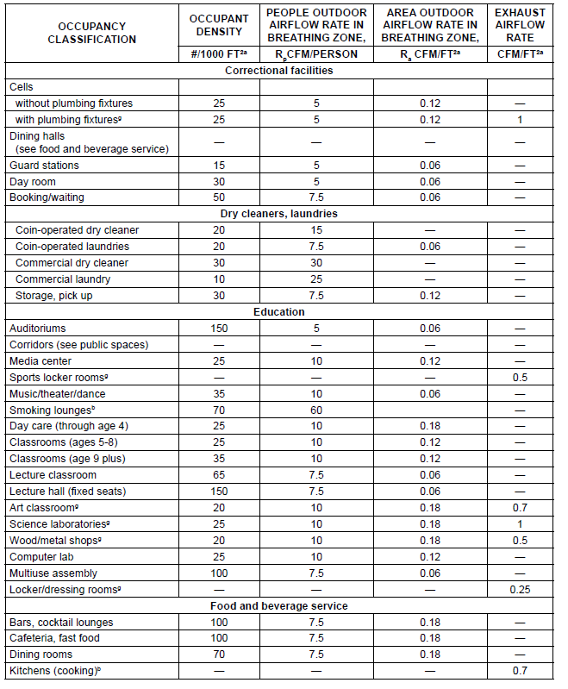
Section 403.3 Minimum Air Flow Rates
BREATHING ZONES
OCCUPIABLE SPACE
Exhaust Airflow Rate

Slide 29
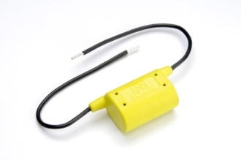
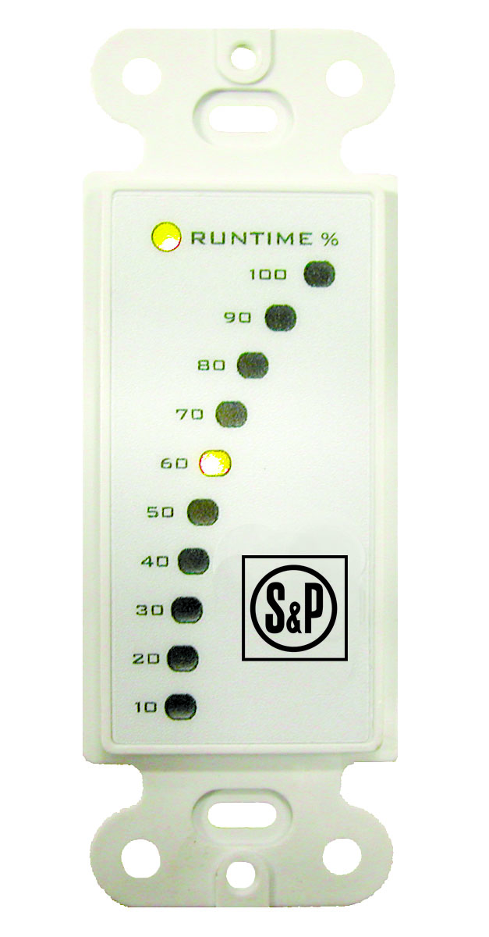
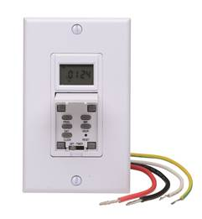
Section 404.6 Variable Air Volume System Control
The Code Specifies:
Controls required to regulate the flow of outdoor air
Control system must be designed to maintain the outdoor airflow rate required by Section 403.3
S&P Solutions for Controls
CVC – Continuous Ventilation Controls
Designed exclusively for TD-100, TD-100x and TD-150 to allow the fans to run continuously at a low rate
Percentage Timers
Multiple options based on fan chosen!
TR Specific
HR Specific
General Options
Section 1502 M1502

Slide 30
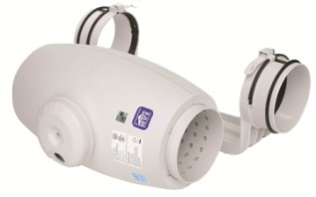
Conclusions
S&P Exhaust & Supply Options
What we have learned
TD-MIXVENT and TD-SILENT
Supply Air is just as important as Exhaust Air
S&P offers a number of efficient and cost effective solutions to the IRC 2012 Chapter 15 Requirements
All the products we discussed in the residential section translate into commercial.
PC-Premium CHOICE Fans
TR & HR (ERVs & HRVs)

Slide 31
Thank you! Any Questions?

